Slide 1
Introduction to Java

Slide 2
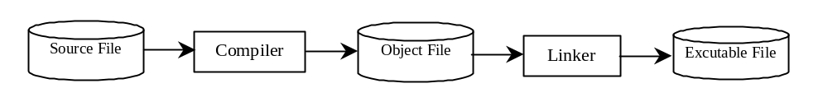
Compiling Source Code
A program written in a high-level language is called a source program.
Program called a compiler is used to translate the source program into a machine language program called an object program.
The object program is often then linked with other supporting library code before the object can be executed on the machine.

Slide 3
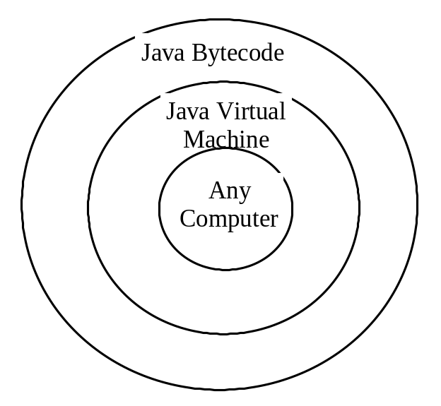
Compiling Java Source Code
Object program can only run on a specific machine, hence source program must be recompiled for different machines
Java was designed to run object programs on any platform.
Java program is compiled into a special type of object code, known as bytecode
The bytecode can then run on any computer with a Java Virtual Machine ( it interprets Java bytecode)

Slide 4
Why Java?
The answer is that Java enables users to develop and deploy applications on
the Internet for servers
desktop computers
small hand-held devices
Java is known as the Internet programming language and is also a general-purpose programming language.

Slide 5
Java, Web, and Beyond
Java can be used to develop:
Java Applets
Java Web Applications
Java can also be used to develop applications for hand-held devices such as cell phones and tablets

Slide 6
Java’s History
James Gosling and Sun Microsystems
Initially called Oak
Renamed to Java on May 20, 1995
HotJava
  The first Java-enabled Web browser
Early History Website:
http://java.sun.com/features/1998/05/birthday.html

Slide 7
Characteristics of Java
Java Is Simple
Java Is Object-Oriented
Java Is Distributed
Java Is Interpreted
Java Is Robust
Java Is Secure
Java Is Architecture-Neutral
Java Is Portable
Java's Performance
Java Is Multithreaded
Java Is Dynamic

Slide 8
Characteristics of Java
Java Is Simple
Java Is Object-Oriented
Java Is Distributed
Java Is Interpreted
Java Is Robust
Java Is Secure
Java Is Architecture-Neutral
Java Is Portable
Java's Performance
Java Is Multithreaded
Java Is Dynamic
Java is partially modeled on C++, but greatly simplified and improved. Some people refer to Java as "C++--" because it is like C++ but with more functionality and fewer negative aspects.

Slide 9
Characteristics of Java
Java Is Simple
Java Is Object-Oriented
Java Is Distributed
Java Is Interpreted
Java Is Robust
Java Is Secure
Java Is Architecture-Neutral
Java Is Portable
Java's Performance
Java Is Multithreaded
Java Is Dynamic
Java is inherently object-oriented. Although many object-oriented languages began strictly as procedural languages, Java was designed from the start to be object-oriented. Object-oriented programming (OOP) is a popular programming approach that is replacing traditional procedural programming techniques.
One of the central issues in software development is how to reuse code. Object-oriented programming provides great flexibility, modularity, clarity, and reusability through encapsulation, inheritance, and polymorphism.

Slide 10
Characteristics of Java
Java Is Simple
Java Is Object-Oriented
Java Is Distributed
Java Is Interpreted
Java Is Robust
Java Is Secure
Java Is Architecture-Neutral
Java Is Portable
Java's Performance
Java Is Multithreaded
Java Is Dynamic
Distributed computing involves several computers working together on a network. Java is designed to make distributed computing easy. Since networking capability is inherently integrated into Java, writing network programs is like sending and receiving data to and from a file.

Slide 11
Characteristics of Java
Java Is Simple
Java Is Object-Oriented
Java Is Distributed
Java Is Interpreted
Java Is Robust
Java Is Secure
Java Is Architecture-Neutral
Java Is Portable
Java's Performance
Java Is Multithreaded
Java Is Dynamic
You need an interpreter to run Java programs. The programs are compiled into the Java Virtual Machine code called bytecode. The bytecode is machine-independent and can run on any machine that has a Java interpreter, which is part of the Java Virtual Machine (JVM).

Slide 12
Characteristics of Java
Java Is Simple
Java Is Object-Oriented
Java Is Distributed
Java Is Interpreted
Java Is Robust
Java Is Secure
Java Is Architecture-Neutral
Java Is Portable
Java's Performance
Java Is Multithreaded
Java Is Dynamic
Java compilers can detect many problems that would first show up at execution time in other languages.
Java has eliminated certain types of error-prone programming constructs found in other languages.
Java has a runtime exception-handling feature to provide programming support for robustness.

Slide 13
Characteristics of Java
Java Is Simple
Java Is Object-Oriented
Java Is Distributed
Java Is Interpreted
Java Is Robust
Java Is Secure
Java Is Architecture-Neutral
Java Is Portable
Java's Performance
Java Is Multithreaded
Java Is Dynamic
Java implements several security mechanisms to protect your system against harm caused by stray programs.

Slide 14
Characteristics of Java
Java Is Simple
Java Is Object-Oriented
Java Is Distributed
Java Is Interpreted
Java Is Robust
Java Is Secure
Java Is Architecture-Neutral
Java Is Portable
Java's Performance
Java Is Multithreaded
Java Is Dynamic
Write once, run anywhere
With a Java Virtual Machine (JVM), you can write one program that will run on any platform.

Slide 15
Characteristics of Java
Java Is Simple
Java Is Object-Oriented
Java Is Distributed
Java Is Interpreted
Java Is Robust
Java Is Secure
Java Is Architecture-Neutral
Java Is Portable
Java's Performance
Java Is Multithreaded
Java Is Dynamic
Because Java is architecture neutral, Java programs are portable. They can be run on any platform without being recompiled.

Slide 16
Characteristics of Java
Java Is Simple
Java Is Object-Oriented
Java Is Distributed
Java Is Interpreted
Java Is Robust
Java Is Secure
Java Is Architecture-Neutral
Java Is Portable
Java's Performance
Java Is Multithreaded
Java Is Dynamic
Initially, Java’s performance was criticized. It was because the bytecode was interpreted. Now we have optimized JVM and better CPU’s.

Slide 17
Characteristics of Java
Java Is Simple
Java Is Object-Oriented
Java Is Distributed
Java Is Interpreted
Java Is Robust
Java Is Secure
Java Is Architecture-Neutral
Java Is Portable
Java's Performance
Java Is Multithreaded
Java Is Dynamic
Multithread programming is smoothly integrated in Java, whereas in other languages you have to call procedures specific to the operating system to enable multithreading.

Slide 18
Characteristics of Java
Java Is Simple
Java Is Object-Oriented
Java Is Distributed
Java Is Interpreted
Java Is Robust
Java Is Secure
Java Is Architecture-Neutral
Java Is Portable
Java's Performance
Java Is Multithreaded
Java Is Dynamic
Java was designed to adapt to an evolving environment. New code can be loaded on the fly without recompilation. There is no need for developers to create, and for users to install, major new software versions. New features can be incorporated transparently as needed.

Slide 19
JDK Editions
Java Standard Edition (J2SE)
  J2SE can be used to develop client-side standalone applications or applets.
Java Enterprise Edition (J2EE)
  J2EE can be used to develop server-side applications such as Java servlets and Java ServerPages.
Java Micro Edition (J2ME).
  J2ME can be used to develop applications for mobile devices such as cell phones.

Slide 20
Popular Java IDEs
NetBeans Open Source by Sun
Eclipse Open Source by IBM
Borland JBuilder 2007 (Based on Eclipse)

Slide 21
A Simple Java Program (Example 1)
HelloWorld program
Edit using notepad/wordpad
Compile using javac command
Execute using java command

Slide 22
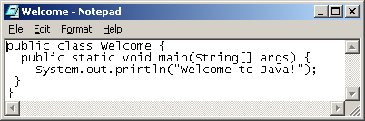
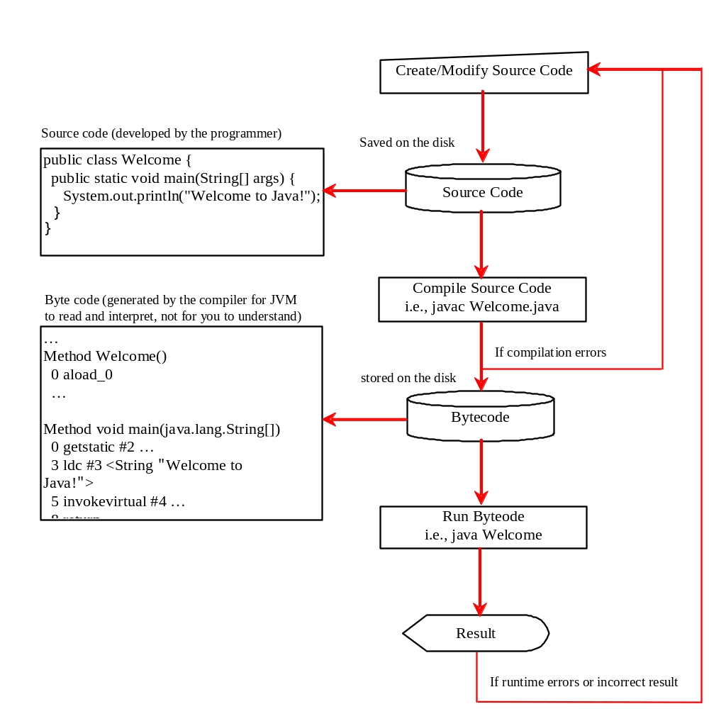
Creating, Compiling, and Running Programs

Slide 23
Trace a Program Execution
Enter main method
//This program prints Welcome to Java!
public class Welcome {
public static void main(String[] args) {
System.out.println("Welcome to Java!");
}
}

Slide 24
Trace a Program Execution
Execute statement
//This program prints Welcome to Java!
public class Welcome {
public static void main(String[] args) {
System.out.println("Welcome to Java!");
}
}

Slide 25

Trace a Program Execution
//This program prints Welcome to Java!
public class Welcome {
public static void main(String[] args) {
System.out.println("Welcome to Java!");
}
}
print a message to the console

Slide 26

Compiling and Running Java from the Command Window
Set path to JDK bin directory
  set path=c:\Program Files\java\jdk1.6.0\bin
Set classpath to include the current directory
  set classpath=.
Compile
  javac Welcome.java
Run
  java Welcome

Slide 27
Anatomy of a Java Program
Comments
Package
Reserved words
Modifiers
Statements
Blocks
Classes
Methods
The main method
Variables

Slide 28
Programming Style and Documentation
Appropriate Comments
Naming Conventions
Proper Indentation and Spacing Lines
Block Styles

Slide 29
Naming Conventions
Choose meaningful and descriptive names.
Variables and method names:
  Use lowercase. If the name consists of several words, concatenate all in one, use lowercase for the first word, and capitalize the first letter of each subsequent word in the name. For example, the variables radius and area, and the method computeArea.

Slide 30
Naming Conventions, cont.
Class names:
  Capitalize the first letter of each word in the name. For example, the class name ComputeArea.
Constants:
  Capitalize all letters in constants, and use underscores to connect words. For example, the constant PI and MAX_VALUE

Slide 31
Proper Indentation and Spacing
Indentation
  Indent two spaces.
Spacing
  Use blank line to separate segments of the code.

Slide 32
Monetary Units – ComputeChange Program (Example 2)
This program lets the user enter the amount in decimal representing dollars and cents
It outputs a report listing the monetary equivalent in single dollars, quarters, dimes, nickels, and pennies.
The program should report maximum number of dollars, then the maximum number of quarters, and so on, in this order.

Slide 33
Trace ComputeChange
Suppose amount is 11.56
int remainingAmount = (int)(amount * 100);
// Find the number of one dollars
int numberOfOneDollars = remainingAmount / 100;
remainingAmount = remainingAmount % 100;
// Find the number of quarters in the remaining amount
int numberOfQuarters = remainingAmount / 25;
remainingAmount = remainingAmount % 25;
// Find the number of dimes in the remaining amount
int numberOfDimes = remainingAmount / 10;
remainingAmount = remainingAmount % 10;
// Find the number of nickels in the remaining amount
int numberOfNickels = remainingAmount / 5;
remainingAmount = remainingAmount % 5;
// Find the number of pennies in the remaining amount
int numberOfPennies = remainingAmount;
remainingAmount
1156
remainingAmount initialized

Slide 34
Trace ComputeChange
Suppose amount is 11.56
int remainingAmount = (int)(amount * 100);
// Find the number of one dollars
int numberOfOneDollars = remainingAmount / 100;
remainingAmount = remainingAmount % 100;
// Find the number of quarters in the remaining amount
int numberOfQuarters = remainingAmount / 25;
remainingAmount = remainingAmount % 25;
// Find the number of dimes in the remaining amount
int numberOfDimes = remainingAmount / 10;
remainingAmount = remainingAmount % 10;
// Find the number of nickels in the remaining amount
int numberOfNickels = remainingAmount / 5;
remainingAmount = remainingAmount % 5;
// Find the number of pennies in the remaining amount
int numberOfPennies = remainingAmount;
remainingAmount
1156
numberOfOneDollars
11
numberOfOneDollars assigned

Slide 35
Trace ComputeChange
Suppose amount is 11.56
int remainingAmount = (int)(amount * 100);
// Find the number of one dollars
int numberOfOneDollars = remainingAmount / 100;
remainingAmount = remainingAmount % 100;
// Find the number of quarters in the remaining amount
int numberOfQuarters = remainingAmount / 25;
remainingAmount = remainingAmount % 25;
// Find the number of dimes in the remaining amount
int numberOfDimes = remainingAmount / 10;
remainingAmount = remainingAmount % 10;
// Find the number of nickels in the remaining amount
int numberOfNickels = remainingAmount / 5;
remainingAmount = remainingAmount % 5;
// Find the number of pennies in the remaining amount
int numberOfPennies = remainingAmount;
remainingAmount
56
numberOfOneDollars
11
remainingAmount updated

Slide 36
Trace ComputeChange
Suppose amount is 11.56
int remainingAmount = (int)(amount * 100);
// Find the number of one dollars
int numberOfOneDollars = remainingAmount / 100;
remainingAmount = remainingAmount % 100;
// Find the number of quarters in the remaining amount
int numberOfQuarters = remainingAmount / 25;
remainingAmount = remainingAmount % 25;
// Find the number of dimes in the remaining amount
int numberOfDimes = remainingAmount / 10;
remainingAmount = remainingAmount % 10;
// Find the number of nickels in the remaining amount
int numberOfNickels = remainingAmount / 5;
remainingAmount = remainingAmount % 5;
// Find the number of pennies in the remaining amount
int numberOfPennies = remainingAmount;
remainingAmount
56
numberOfOneDollars
11
numberOfOneQuarters
2
numberOfOneQuarters assigned

Slide 37
Trace ComputeChange
Suppose amount is 11.56
int remainingAmount = (int)(amount * 100);
// Find the number of one dollars
int numberOfOneDollars = remainingAmount / 100;
remainingAmount = remainingAmount % 100;
// Find the number of quarters in the remaining amount
int numberOfQuarters = remainingAmount / 25;
remainingAmount = remainingAmount % 25;
// Find the number of dimes in the remaining amount
int numberOfDimes = remainingAmount / 10;
remainingAmount = remainingAmount % 10;
// Find the number of nickels in the remaining amount
int numberOfNickels = remainingAmount / 5;
remainingAmount = remainingAmount % 5;
// Find the number of pennies in the remaining amount
int numberOfPennies = remainingAmount;
remainingAmount
6
numberOfOneDollars
11
numberOfQuarters
2
remainingAmount updated

